Slide 1
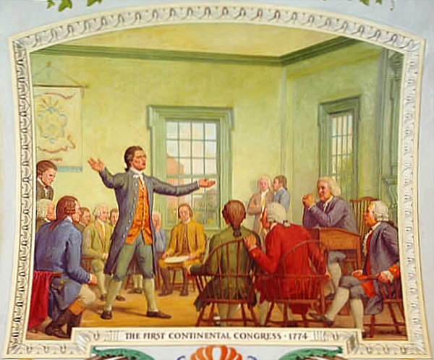
Do Now:
Take HW out & pass toward the front board
First Continental Congress Reading
Your objective:
Read through the 3 paragraphs
Make sure to annotate! THIS IS NOT AN OPTION

Slide 2
The Revolution Begins. . .
British General Gage has secret plan
Lexington - capture colonial leads Sam Adams & John Hancock
Concord - seize gunpowder
Spies & friends of the Americans leak Gage’s plan
Paul Revere & others warn the “The British are Coming!”
Minutemen - select members from colonial militias who could be ready “in a minutes time”

Slide 3
240 British soldiers arrive in Lexington
70 minutemen formed & waiting
April 18, 1775 - First shots of the Revolution are fired at Lexington
British turn back towards Boston
16 mile journey
More minutemen fire on British from behind trees & fences
Nearly 200 British & 90 American men died during the battle

Slide 4
Second Continental Congress
May 10, 1775 - delegates of the Second Continental Congress met at the State House in Philadelphia
65 representatives from 13 colonies
John Adams-wanted to organize a Continental Army w/troops from each of the 13 colonies
Congress asks George Washington to be the commander - HE ACCEPTS!!

Slide 5
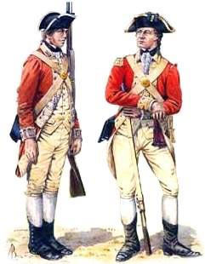
Loyalist
Supported Great Britain
Fought in British Army
Spied on American soldiers
Burned the homes & farms of Patriots

Slide 6
Patriot
Continental Army:
Militia were poorly trained & didn’t have weapons
Training camps were dirty
NEEDED: Money, supplies, training & loyalty
Patriot:
Willing to support the first against Great Britain
Volunteered to fight
Helped to raise money for the war

Slide 7
The Vote!
On a Post-it write down which side you would pick & why.
Patriot v. Loyalist

Slide 8
Homework:
Thomas Paine & Common Sense Worksheet

