Slide 1
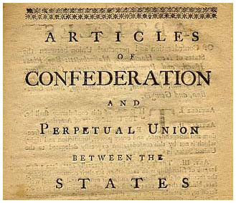
Do Now:
Take out HW & notebooks
Pass HW towards the FRONT board
Take textbook from the bookshelf & have a seat

Slide 2
Strength & Weaknesses of the Articles of Confederation
As a class we will read the following pages/sections in your textbook
Using TEXT EVIDENCE, you will create a T-Chart illustrating the strengths & weaknesses of the Articles of Confederation
Record out responses!
Textbook Pages 156-159
The Articles of Confederation: America’s First Constitution
The World’s Ugly Duckling

Slide 3
Shay’s Rebellion: uprising led by a former militia officer, Daniel Shays, which broke out in western Massachusetts in 1786.
Grievances:
Taxes to be cut
Revision of the poll tax law to be based on income
To issue paper money & make it legal tender - "Tender Laws"
Institute "Stay Laws" (freeze) on payment of debts
Accept a barter system as a form of payment
Reduce legal fees of the courts and lawyers
Move the location of the state capital inland, near the farmers so it would no longer be in the control of the commercial elite in eastern Massachusetts

Slide 4
Exit Slip
THREE things you learned about the Articles of Confederation
TWO things you found interesting about the document
ONE question you still may have
3-2-1

