Slide 1
Do Now:
Expectations:
Do Now is to be done in silence.
When class begins, scholars are prepared & ready to work.
During lesson, scholars are following our “Classroom Norms.”
Remember. . . .
R-E-S-P-E-C-T
Pass HW towards the window.
Take out a notebook/looseleaf paper & something to write with.
Be prepared to work!
You WILL be taking independent notes

Slide 2
Mercantilism
Please take 1 Notice & 1 Wonder note during video!
Definition: the economic ($$) theory that trade generates wealth
13 colonies: colonies existed for the good of the mother country.

Slide 3
The Birth of the Triangle Trade . . .
1651 - Navigation Act
all goods imported into England or the colonies must arrive in English ships.
1660- law required that certain specified goods must be shipped only to England or the colonies.
“Enumerated goods” were tobacco, cotton, indigo, sugar, and a few other items.
1676- English gov’t sent Edward Randolph to Boston to check on the enforcement of the Navigation Acts
Merchants and shippers ignored the Navigation Acts.

Slide 4
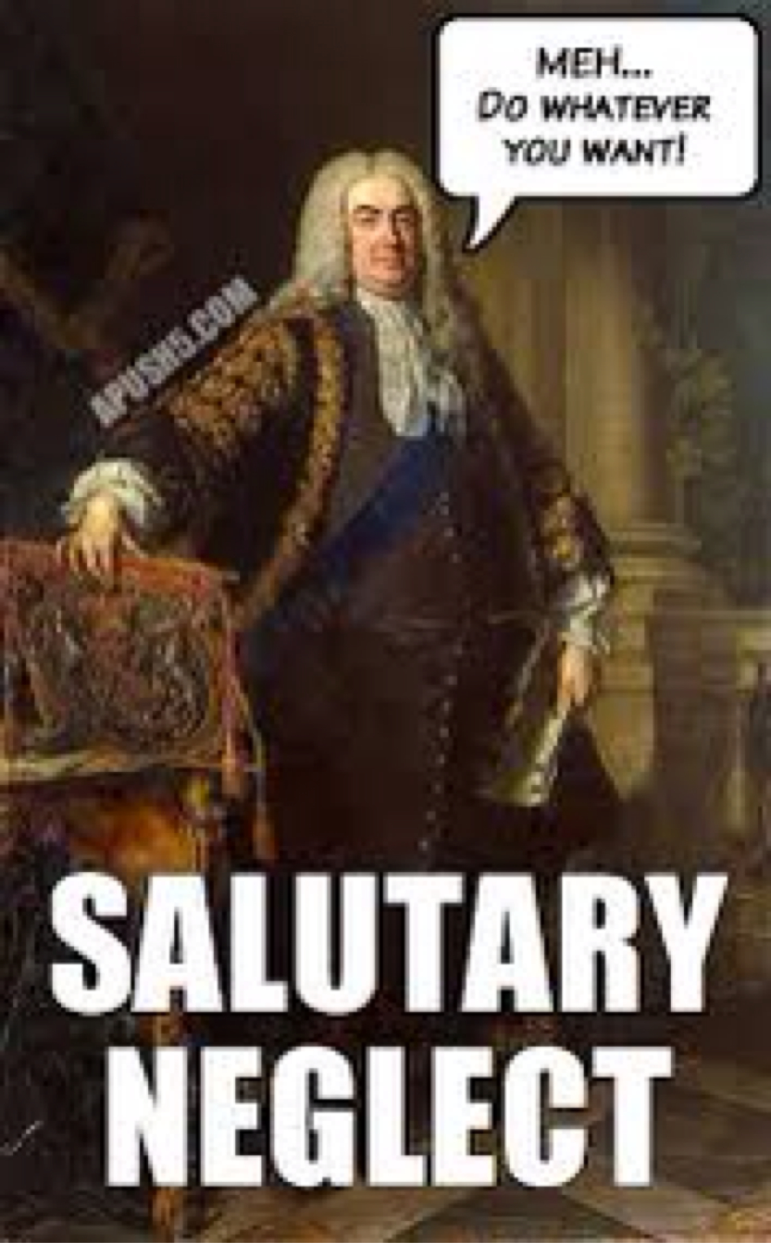
Salutary Neglect
Navigation Act of 1696- colonial governors to enforce the Navigation Acts & permitted customs officials to use general search warrants called “writs of assistance.”
Board of Trade- investigated violations of the Navigation Acts
subjected the colonies to royal control and was vigorous in enforcing the Acts
1725- Britain had entered into a period of “salutary neglect.”
policy of avoiding strict enforcement of parliamentary laws meant to keep American colonies obedient to England

Slide 5
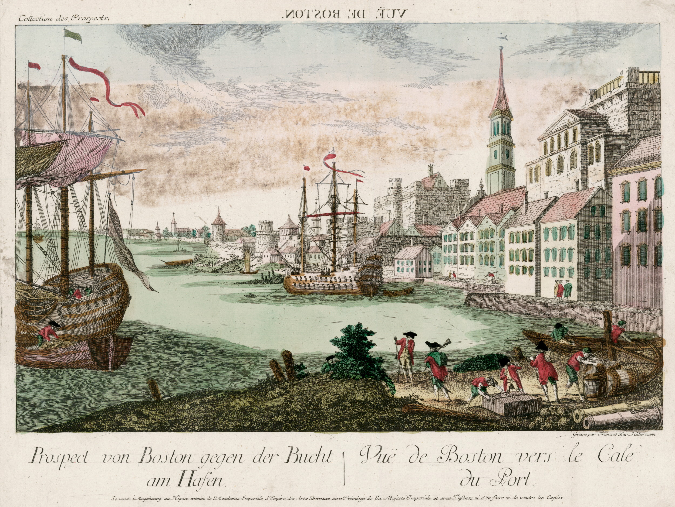
Colonial Entrepreneurs
End of the century- colonies had become prime players in the commercial activity of the North Atlantic
Legal trade with Britain and the British West Indies
Illegally with France, Spain, Portugal, and Holland.

Slide 6
CFU! 10 Steps…
Explain mercantilism.

Slide 7
America & the British West Indies
Fish, livestock, flour, and lumber to the British West Indies
In return = sugar, molasses, indigo and other products including citrus fruits
Simple manufactured goods from America were exchanged for slaves (ex. rum)
England
Sugar, molasses, indigo and other products including citrus fruits from America
In exchange for manufactured goods that were then carried back to the North American colonies
The Triangle Trade
Africa
slaves were then transported to the West Indies where they were traded for molasses
Molasses was used to make rum, typically in Rhode Island distilleries, and shipped to West Africa for more slaves to be sold in the West Indies or in the North American colonies.

Slide 8
CFU! Fist to Five!
In your own words, describe the triangle trade.

Slide 9
The Middle Passage
Middle Passage: the sea journey undertaken by slave ships from West Africa to the West Indies.
Journey might take three weeks. Unfavorable weather conditions could make the trip much longer.
The slaves were branded with hot irons and restrained with shackles
Slaves were fed twice daily and some captains
Air holes were cut into the deck to allow the slaves breathing air, but these were closed in stormy conditions.

Slide 10
Continued. . .
There was not even enough space to place buckets for human waste -- disease was prevalent
The bodies of the dead were simply thrust overboard.
LOOSE PACKING-provided for fewer slaves per ship in the hopes that a greater percentage of the cargo would arrive alive.
TIGHT PACKING- captains believed that more slaves, despite higher casualties, would yield a greater profit at the trading block.

Slide 11
CFU! Ice Cream Social
What impact did the Middle Passage the colonies?

Slide 12
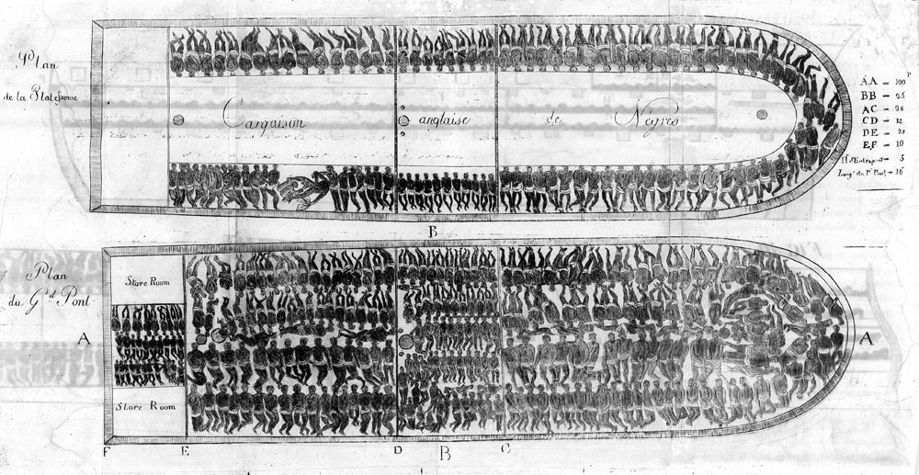

Slide 13
Exit Slip:
Write down two important factor of the Triangle Trade & the impact it had on the 13 colonies.

Slide 14
Homework:
John Newton was a slave trader for nine years (1745 to 1754). He returned to England and became a minister and an abolitionist. He is famous for writing the Christian hymn “Amazing Grace.”
Amazing grace! How sweet the sound
That saved a wretch like me!
I once was lost, but now am found;
Was blind, but now I see.
Writing Prompt (4-8 sent.):
Knowing that John Newton was a former Slave trader, what do you think he was trying to saying in the beginning of this hymn? What lines or words in the first part of this song lead you to believe this?

